Slide 1
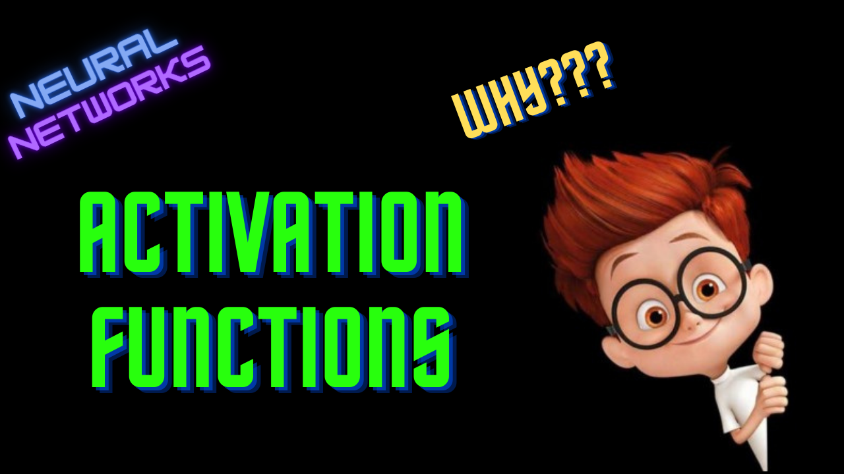

Slide 2
Activation Functions
ML For Nerds

Slide 3



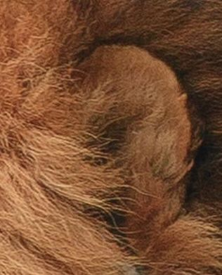

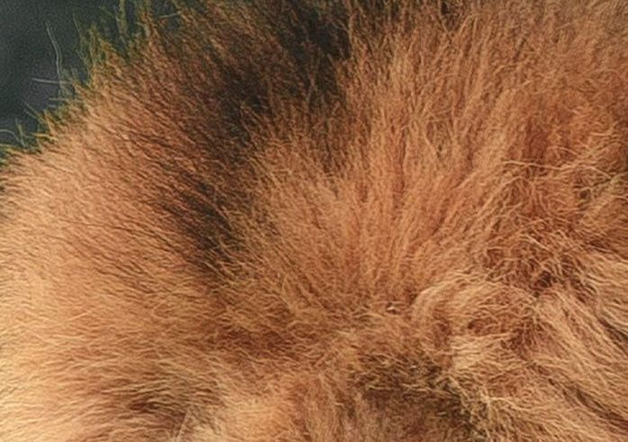




Network
1
1 - Yes
2
2
0 - No
1
4
1
Lion
Or
Not
0
1
0
2
2
1
1
0
1
0
Step Function

Slide 4
Why activation function?
Restricting the output to a specific range
Introducing non-linearity

Slide 5
Properties
Non-linearity
Differentiable
Range
Monotonic
Computationally efficient

